Slide 1
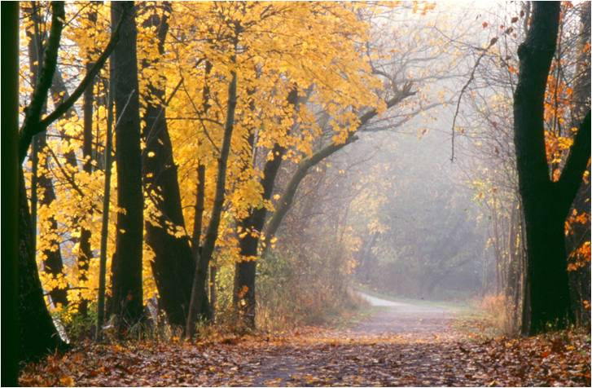
Trail Design & Construction Challenges in Cuyahoga Valley National Park
Robert W. Bobel, P.E.
Park Engineer
Cuyahoga Valley National Park
Greater Cleveland Trails and Greenways Conference
Given June 7, 2010
Middleburg Heights, OH

Slide 2
Trail Users + Trail Location = Design Standards Design Standards → Width, grades, surface Surface = Costs (initial + maintenance)
Notes:
Other considerations beyond surface:
Structures
Utilities
Long-term maintenance costs

Slide 3
Trail Users
Surface
Width
Grades
Trailheads
Trail amenities
Notes:
Cyclists
Equestrians
Roller bladers
Other trail users

Slide 4
Trail Location
Crossings
Along water courses
Environmental
Cultural
Notes:
Rural
Urban
Access to Utilities
Trailheads

Slide 5
River and stream erosion
Notes:
On-going challenges
If you have bank erosion issues when the route is chosen, expect them to continue.

Slide 6
Flooding
Notes:
On going challenges

Slide 7
Aggregate Surfaces
Crushed Rolled Limestone
Gravel & Sand Mix
Natural earthen
Notes:
Access to materials

Slide 8
Paved Hardened Surface
Asphalt
Notes:
First choice for many

Slide 9
Paved Hardened Surface
Concrete
Notes:
Ideal for some urban areas

Slide 10
Paved Hardened Surface
Specialty surfaces
Notes:
Recycled rubber

Slide 11
Other Hardened Surface
Boardwalks
Notes:
Recycled rubber

Slide 12
Trail Surfaces
Limestone – Asphalt – Concrete (initial costs)
$ → $$ → $$$
(maintenance costs)
$$$ → $$ → $
Notes:
CVNP costs for maintenance of towpath $16,100/mi.
Deferred costs of $47,600/mi.

Slide 13
Limestone - Advantages
Lower Initial Cost
Softer Appearance
More Giving Surface
More absorption
Slower Speeds
Notes:
Good for rural and areas with lighter traffic

Slide 14
Limestone - Disadvantages
Requires Regular Maintenance
Requires time to set up
Limited to flatter trails
Spring Tundra
Summer Dusting
Notes:
Max slope 3-4%
Change soil pH

Slide 15
Bank Erosion
Gabion walls
Gabion protected slopes
Notes:
Not good long term solution in high flow areas

Slide 16
Bank Erosion – lower flows
Live staking
Brush matting
Root wads
Notes:
Can be used in combination with rip rap toe protection

Slide 17
Bank Erosion – typical details
Stone rip rap
Brush layering
Soil Wraps
Notes:
Can eliminate soil wraps for shallower slopes

Slide 18
Bank Erosion – higher flows
Stone rip rap
Brush layering
Soil Wraps
Notes:
Soil bioengineering

Slide 19
Bank Erosion – innovative techniques
Spurs & vanes
Buried windrows
Engineered log jams
Notes:
Cutting edge can be the bleeding edge

Slide 20
Flooding
Clean-up
Repair
Harden
Notes:
Live with it, it will happen again!

Slide 21
Contract out or construct in-house?
Notes:
Think a government contractor owns this boat?

Slide 22
Manage Expectations
Notes:
Our job as planners: Plan for the users you will have, not the users you would like to have.
But, think about ways to expend, if necessary.

Slide 23
Trail Challenges - Summary
Notes:
Get to know your trails and your trail users.

